Slide 1

Flight delay analysis report

Slide 2
Challenges faced
Challenge of Loading Bulk Data
Performance Issues
Data cleaning
Data Modeling
Complex Queries and Computations
Visualization Challenges

Slide 3
Insights from the analysis
A significantly higher number of flights are operated on weekdays (770.86K flights) compared to weekends (277.72K flights).
JetBlue Airlines had no cancellations on the first day of January month.
JetBlue Airlines had high number of cancellations(42) on the first day of February.
Southwest Airlines Co. has the highest delays across all, with 1458K (weekdays) and 595K (weekends) delays followed by Atlantic Southeast Airlines in weekday and American Airlines on weekends.
United Airlines has more punctuality when compared to other airlines.
Flights are covering more distance on weekdays when compared to weekends.

Slide 4
Problem statement
Traffic Congestion on Weekdays:
High flight volumes during weekdays may lead to congestion, increasing the likelihood of delays and cancellations.
Unusual Spikes in Cancellations:
February cancellations by JetBlue Airlines suggest potential operational or weather-related issues.
Airline-specific Delay Patterns:
Some airlines consistently exhibit higher delays, indicating possible inefficiencies in scheduling or operational processes.
Impact of Long-distance Flights:
Flights covering longer distances (2500–3000 miles) exhibit more delays, likely due to complexities in coordination and weather changes over vast distances.

Slide 5
recommendations
For Traffic Congestion:
Dynamic Scheduling: Implement dynamic scheduling to spread flight departures and arrivals more evenly across weekdays.
Infrastructure Upgrade: Airports with high weekday traffic should explore capacity upgrades or additional runways and Airlines has to run more flights on weekends.
To Address JetBlue Airlines Cancellations:
Root Cause Analysis:
Conduct a detailed analysis to identify specific reasons behind February's high cancellations (e.g., weather, technical issues, or operational inefficiencies).
Contingency Plans:
Introduce robust contingency plans, such as backup fleets or crew, to handle unexpected disruptions.
For Airline-specific Delay Patterns:
Operational Audits: Airlines with higher delays (e.g., Southwest Airlines) should conduct audits to optimize ground operations, maintenance schedules, and crew availability.
Technology Adoption:
Implement advanced analytics tools for predictive maintenance to prevent technical delays.
General Recommendation
Every airline should follow United Airlines in managing delays.

Slide 6
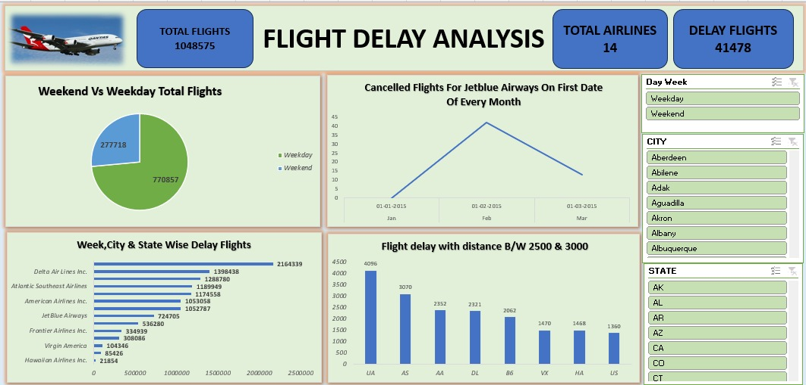
excel analysis for

Slide 7
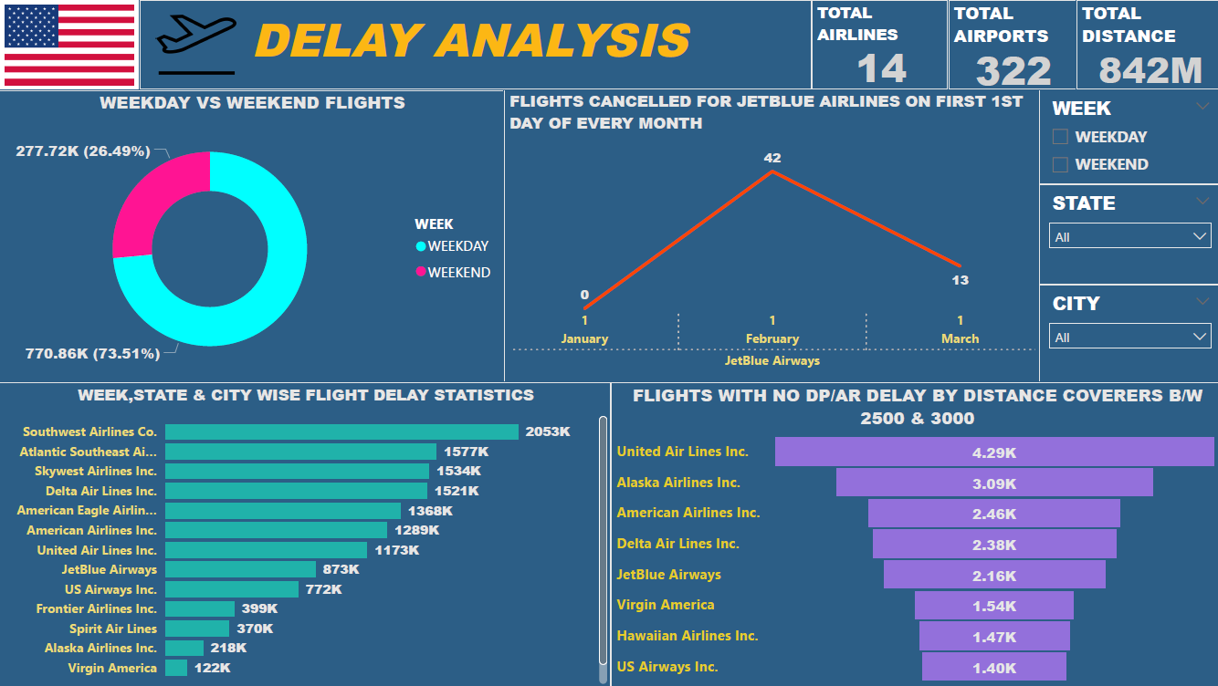
Power bi analysis for

Slide 8
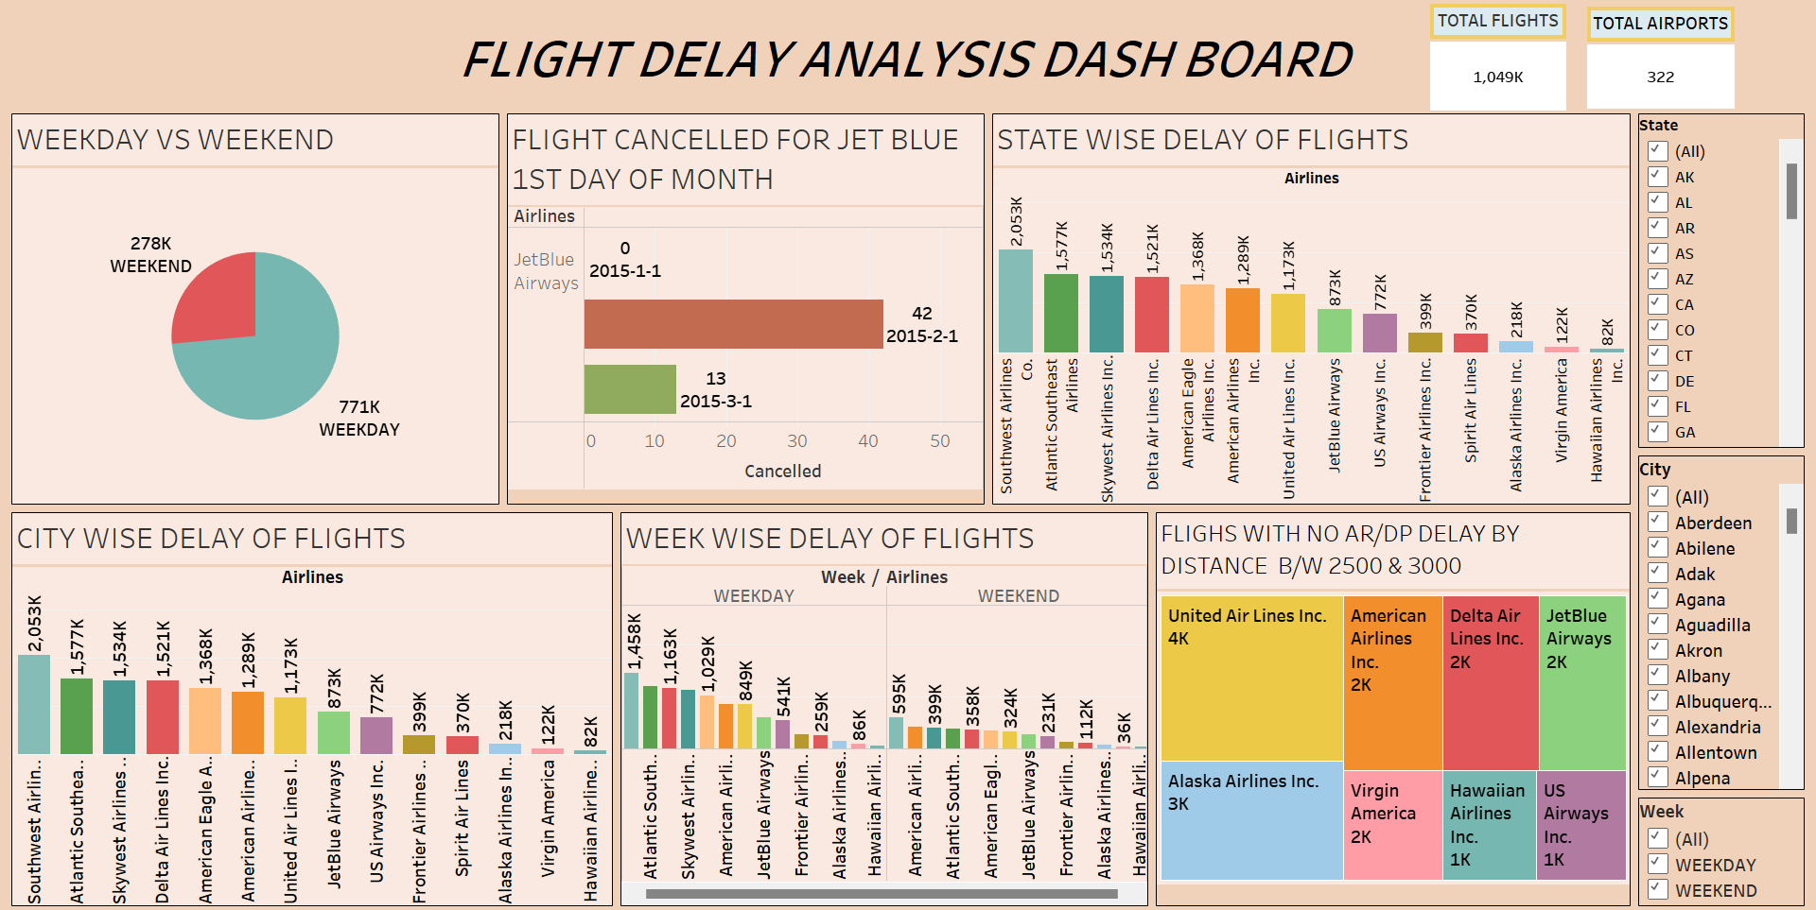
tableau analysis for

Slide 9
Thank you

